Slide 1
Coptic Lesson 6
Coptic Reading

Slide 2
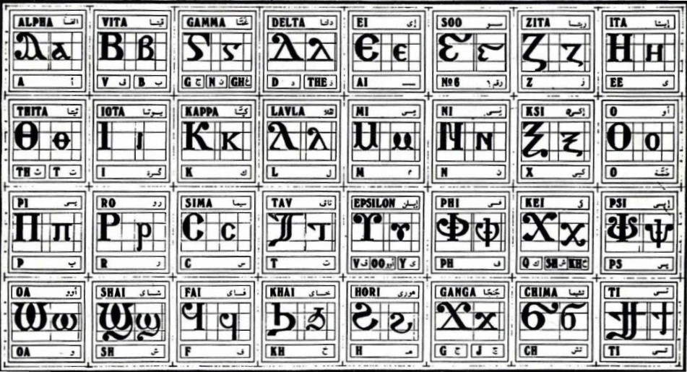
Coptic Alphabets

Slide 3
Review Questions
Coptic
English
Name
d
d, z
Delta
} ]
ti
Tee
i
e, ee, y
Iota
j
g, j
Ganga
^
6
Soo
,
k, sh, kh
Kei
q
Kh
Khai

Slide 4
Rule for the Iota i:
e
(if 1st letter in a word)
ee
I i =
(after or between consonants)
y
(next to a vowel)
Examples:
isi
rwmi
iom
Icrayl
niben
Ic,uroc
nai
`agioc
`<rictoc
`ilewc
Mari`a

Slide 5
Coptic Reading – Part 1
Na ne ni no nw
Ma me mi mo mw
Ba be bi bo bw
Ka ke ki ko kw
Ta te ti to tw
Ca ce ci co cw
Za ze zi zo zw
]a ]e ]i ]o ]w

Slide 6
Coptic Reading – Part 2
an en yn in on wn
am em ym im om wm
ab eb yb ib ob wb
ak ek yk ik ok wk
at et yt it ot wt
ac ec yc ic oc wc
az ez yz iz oz wz
a] e] y] i] o] w]

Slide 7
Coptic Reading – Part 3
,a ,e ,y ,i ,o ,w
da de dy di do dw
Ba be by bi bo bw
ra re ry ri ro rw
Ta te ty ti to tw
Ca ce cy ci co cw
Za ze zy zi zo zw

Slide 8
Coptic Reading – Part 4
a, e, y, i, o, w,
ad ed yd id od wd
aB eb yb ib ob wb
ar er yr ir or wr
am em ym im om wm
aC ec yc ic oc wc
aZ ez yz iz oz wz

Slide 9
Coptic Reading – Part 5
,a ,e ,y ,i ,o ,w
da de dy di do dw
ja je jy ji jo jw
ra re ry ri ro rw
sa se sy si so sw
qa qe qy qi qo qw
ga ge gy gi go gw

Slide 10
Coptic Reading – Part 6
a, e, y, i, o, w,
ad ed yd id od wd
aj ej yj ij oj wj
ar er yr ir or wr
as es ys is os ws
aq eq yq iq oq wq
ag eg yg ig og wg

Slide 11
Coptic Reading – Part 7
va ve vy vi vo vw
pa pe py pi po pw
ja je jy ji jo jw
la le ly li lo lw
;a ;e ;y ;i ;o ;w
[a [e [y [i [o [w
'a 'e 'y 'i 'o 'w

Slide 12
Coptic Reading – Part 8
a[ e[ y[ i[ o[ w[
al el yl il ol wl
av ev yv iv ov wv
a; e; y; i; o; w;
ap ep yp ip op wp
a' e' y' i' o' w'
ag eg yg ig og wg

Slide 13
Coptic Reading – Part 9
va ve vy vi vo vw vou
xa xe xy xi xo xw xou
ja je jy ji jo jw jou
fa fe fy fi fo fw fou
ha he hy hi ho hw hou
[a [e [y [i [o [w [ou
'a 'e 'y 'i 'o 'w 'ou

Slide 14
Coptic Reading – Part 10
a] e] y] i] o] w] ou]
ax ex yx ix ox wx oux
av ev yv iv ov wv ouv
af ef yf if of wf ouf
ah eh yh ih oh wh ouh
a' e' y' i' o' w' ou'
aq eq yq iq oq wq ouq

Slide 15
Coptic Reading – Part 11
na ne ni no nw
fa fe fi fo fou
ra re ri ro rw
ta te ti to tou
ha he hi ho hw
ja je ji jo jw
naf neh nit noj nwr
far fet fin foh fwi
ran ref rit ror rwf
taj ten tin tor tour

Slide 16
Coptic Reading – Part 12
han hei hin hof hwf
jaf jef jij jof jwr
`nte nane `nje `nran `nta
`wou oui rwou jaji taho
`ew oou hoou hani ou
ouai ouoh jwou houi ou`w
nof jwr tote ioh `wou

Slide 17
Coptic Reading – Part 13
ai ia oi io iom
la [i [wm pan ran
cam [ah map mar jij
cat fat `sne cen] qer
qen sai pisai swi piswi
sep syp `fsyp can cyt
con cwni coni pan ran
ial moi amoi iwt cwma
jwr jwri `cnof ]`aco ]`pla
qaq qwq ja[i ren maren

Slide 18
Coptic Reading – Part 14
Yi you nyou hyt sihyt
myt my] taio `mmoc cen]
Ou mwou erw] oui ouwm
Ser sep cap car carra
Ten ten] jwou hwou tyren
]mi fwte fw] ejen tyrou

Slide 19
Reading Exercise
Practice the word Piparaklyton
Pi
Pipa
Piparak
Piparakly
Piparaklyton
Piparaklyton = The comforter

Slide 20
Reading Exercise
Practice the word pipethwou = The evil one
Pi
Pipe
Pipet
Pipethw
Pipethwou
Practice the word piracmoc = The temptation
Pi
Pirac
Piracmoc

Slide 21
Reading Exercise
Practice the word ]metouro = The kingdom
]
]met
]metou
]metouro
Practice the word Pi`,~rictoc = Christ
Pi
Pi`,
Pi`,ric
Pi`,rictoc

Slide 22
Coptic Bible Verses
Anok pe piAlva nem piW ]ar,y nem pijwk ebol. "I am the Alpha and the Omega, the Beginning and the End." (Rev 1:8)
Anok pe piwik `nte `pwnq. "I am the Bread of life." (Jn 6:35)
Anok pe `vouwini `mpikocmoc. "I am the light of the world." (Jn 8:12)
Matai `epekiwt nem tekmau. "Honor your father and your mother." (Eph 6:2)

Slide 23
Coptic Bible Verses – Part 2
Menre teten`eryou Love one another. (I Pet 1:22)
Mosi qen Pi`pneuma Walk in the Spirit. (Gal 5:16)
`Mpererho] ],y gar nemak Fear not, for I am with you. (Isa 41:10)
`Mpermenre pikocmoc Do not love the world. (I Jn 2:15)
`Pqybc `mpicwma pe pibal The lamp of the body is the eye. (Matt 6:22)

Slide 24
Coptic Bible Verses – Part 3
Rasi qen `P[oic `ncyou niben Rejoice in the Lord always. (Phil 4:4)
Twbh `ejen neten`eryou Pray for one another. (Jm 5:16)
Vnou] ouagapy pe God is love. (I Jn 4:16)
Jemnom] anok ai[ro `epikocmoc Be of good cheer, I have overcome the world. (Jn 16:33)
}ar,y `n]covia ]ho] `nte `P[oic te The fear of the Lord is the beginning of wisdom. (Ps 110:10)

Slide 25
Coptic Bible Verses – Part 4
}ar,y `n]covia ]ho] `nte `P[oic te The fear of the Lord is the beginning of wisdom. (Ps 110:10)
}na,w `ntahiryny nwten@ tahiryny `anok ]natyic nwtem Peace I leave with you, My peace I give to you. (Jn 14:27)
Pinah] ,wric ni`hbyou`i `fmwout Faith without works is dead. (James 2:20)
`Eaukec ;ynou nemaf qen piwmc Buried with Him in baptism. (Col 2:12)

Slide 26
Coptic Alphabets

Slide 27

Oujai qen `P[oic

